Slide 1
Development of Spherical Neutron Polarimetry Device
Tianhao Wang
Advisor: Prof. Roger Pynn

Slide 2
Outline
Introduction to Spherical Neutron Polarimetry technology (SNP)
Current existing SNP devices (CryoPAD, MuPAD)
Research goal
Previous research experiment result
Next step research plan
Notes:
[1] Spherical neutron polarimetry with MuPAD - M. Janoschek (2007)

Slide 3
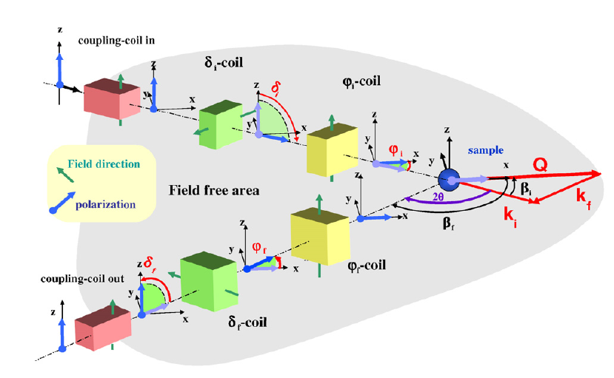
General Description of SNP
Polarized neutron diffraction experiment method
Makes maximum usage of neutron spin manipulation
Introduce and detect neutron spin polarization at any direction
* M. Janoshek (2007)
X: Along Q
Z: Vertical
Y: Form a Cartesian coordinate
Analyzer
& Detector
Notes:
[1] Spherical neutron polarimetry with MuPAD - M. Janoschek (2007)

Slide 4
Basic formulae
Basic formula for polarized neutron scattering developed by Blume (1963) and Maleeve (1999)
: Total scattering cross section : Final polarization
: Initial polarization
: Magnetic scattering vector component perpendicular to (x direction)
Nuclear
Magnetic
Interference
Chiral
Incoherent
Nuclear & incoherent
Magnetic
Interference
Chiral

Slide 5
From formula to experiment - Example
MnWO4 - Pure coherent, magnetic scattering
Want to measure the magnetic and chiral scattering term

Slide 6
Existing SNP device – CryoPAD at ILL since 20 years ago
Developed since over 20 years ago.
pioneer work, massive improvement have been made
nowadays most successful SNP device
Can be mounted on Triple axis spectrometer
- Not limited on scattering angle
- Not limited on elastic scattering
Independent sample control
- temperature, external electric field etc.
Expensive, Labor consuming
- cryogenic liquid drive

Slide 7
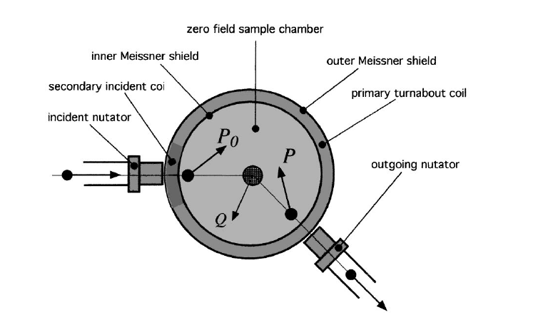
Schematics of CryoPAD
B
B
Nutator: shift neutron spin from parallel to propagation to perpendicular
Precession coil: shift neutron spin via Larmor precesion

Slide 8
Alternative design - MuPAD
Technique highlights
Cryogenic free
- less cost, less work
Can be mounted on Triple axis spectrometer
- available for all kinds of scattering experiment
Polarization controlled by two precession field
Need very careful engineering on Precession coil windings and resident field removal
- High requirement on engineering support, also expensive

Slide 9
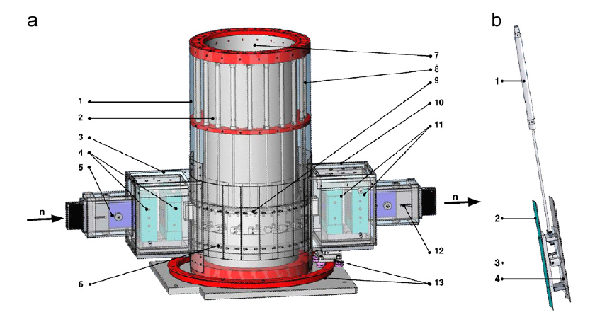
MuPAD Schematics
MuPAD (prototype build in 2004) at FRM-II in German
Design and developed by M. Janoschek

Slide 10
Research Goal
Spherical Neutron Polarimetry is a very powerful experimental method to detect material structure and properties.
Currently no similar device exists in U.S.
Research target:
Develop a device that could fulfill spherical neutron polarimetry experiment method, based on available neutron sources in U.S. (LENS at IU, HFIR at ORNL, NIST? Los Alamos?)
Features of the device:
Use High Tc superconducting material (YBCO) for magnetic field shielding.
Use closed cycle cryogenic stats
Not bound to one single source
Taking advantage of Time of Flight source ?
Notes:
[1] Spherical neutron polarimetry with MuPAD - M. Janoschek (2007)

Slide 11
Research Plan
Build and test precession field shielded by YBCO (Spin nutator)
realize and calibrate Spherical neutron spin manipulation
Small angle neutron scattering based SNP experiment
Build Fully functional SNP device
Condensed matter experiment
(Further Improvement)
(Time of Flight method, advanced sample manipulation……)
Notes:
[1] Spherical neutron polarimetry with MuPAD - M. Janoschek (2007)

Slide 12
First Step of research
Neutron spin nutator
Crucial component of the whole device
Test of High Tc YBCO superconducting material as B field shield
Guide field on rotation stage
(Spin rotator)
Zero field chamber
Front precession field
(spin nutator)
Back precession field
(spin nutator)
Notes:
[1] Spherical neutron polarimetry with MuPAD - M. Janoschek (2007)

Slide 13
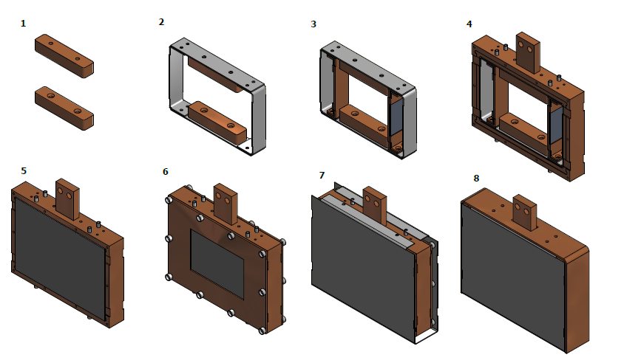
Nutator component and Assemble Procedure
Notes:
[1] Spherical neutron polarimetry with MuPAD - M. Janoschek (2007)

Slide 14
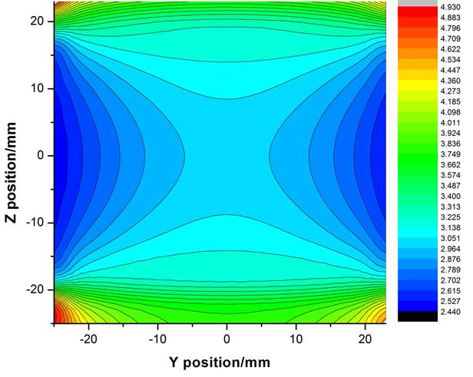
Spin Nutator Simulation using Radia
(Excellent Work from colleague Fankang Li)
Field Integral mapping
Wavelength: 4 Ang
Current: 4 A
180 deg rotation
Dephasing caused by
Inhomogeneity:
(20mm beam size)
< 0.1%
Notes:
[1] Spherical neutron polarimetry with MuPAD - M. Janoschek (2007)

Slide 15
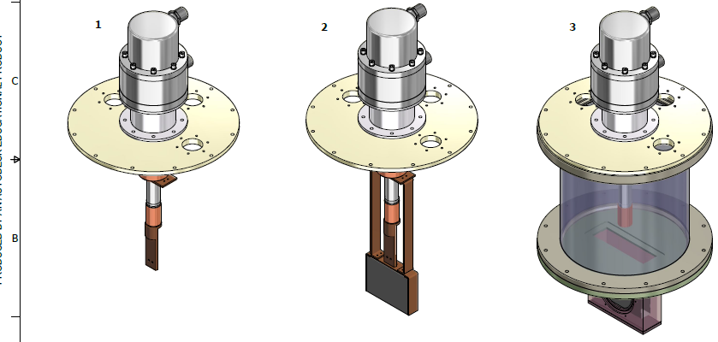
Cryogenic system setup
Notes:
[1] Spherical neutron polarimetry with MuPAD - M. Janoschek (2007)

Slide 16
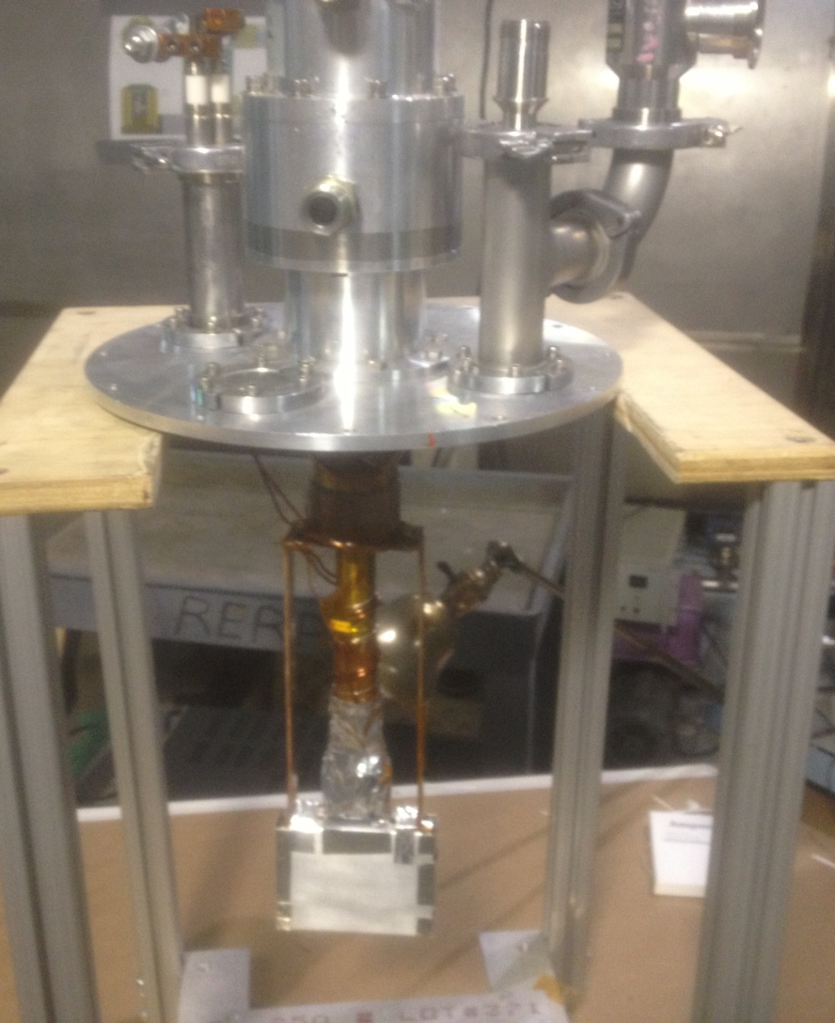
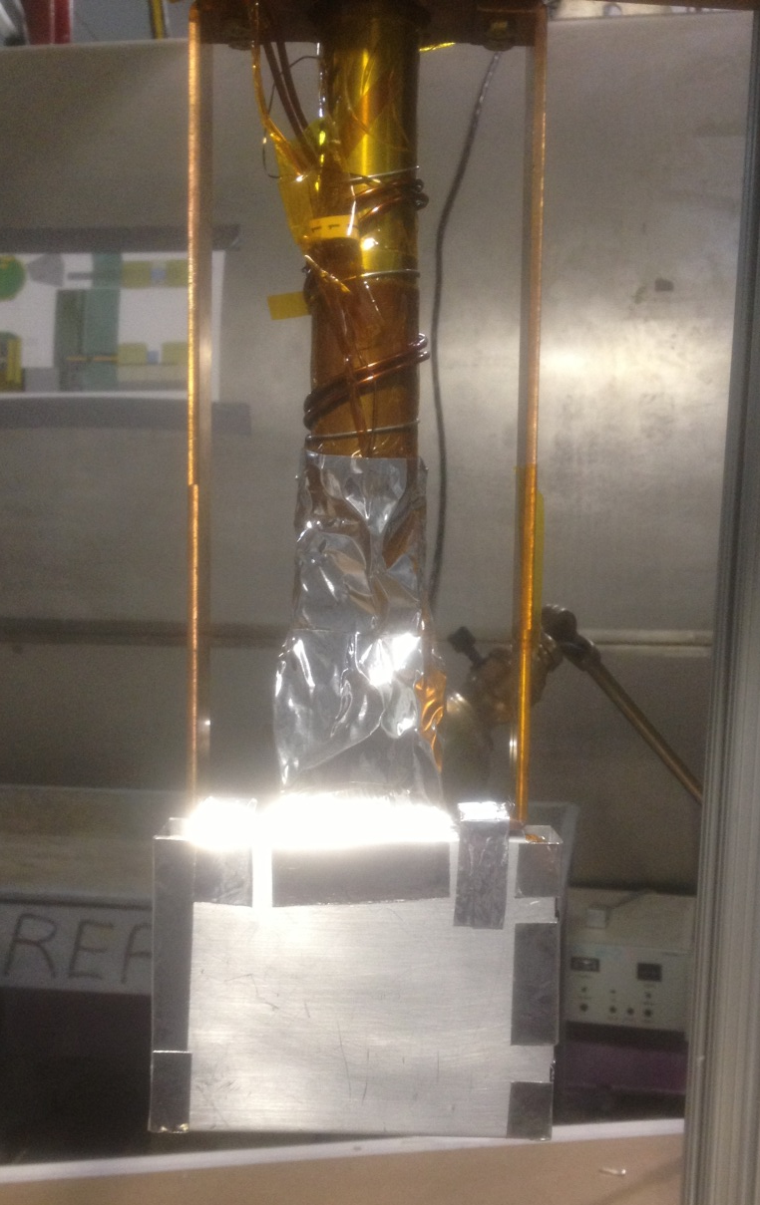
Real Picture and Difficulties
Notes:
[1] Spherical neutron polarimetry with MuPAD - M. Janoschek (2007)

Slide 17
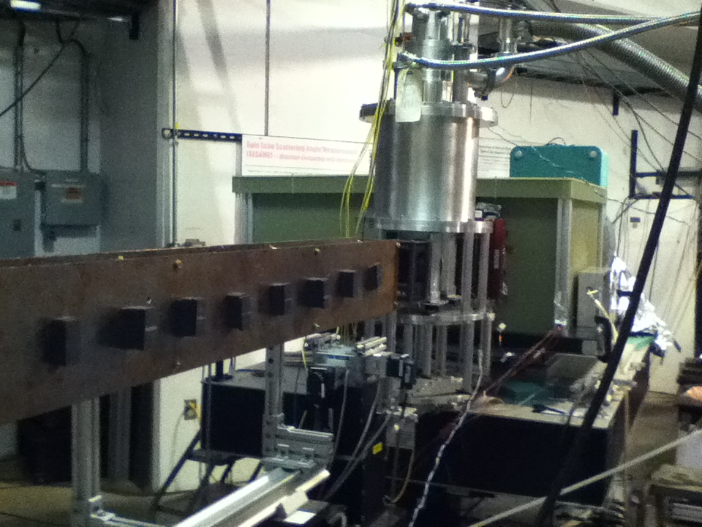
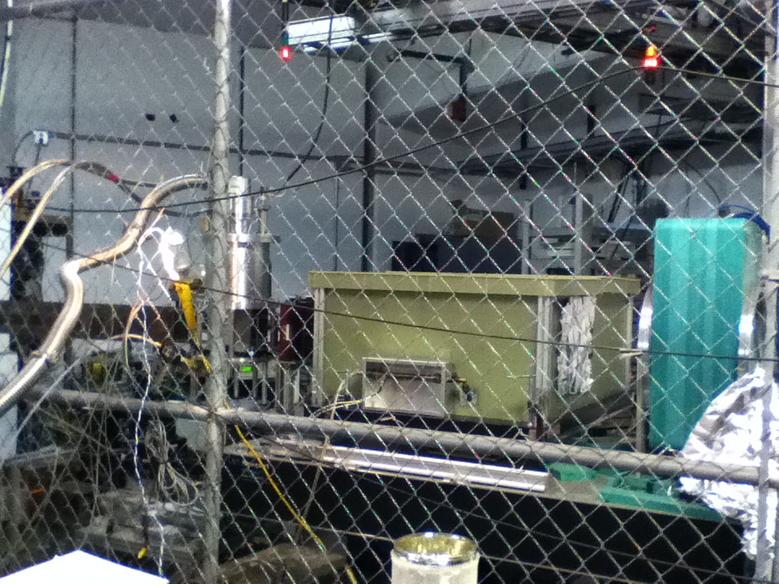
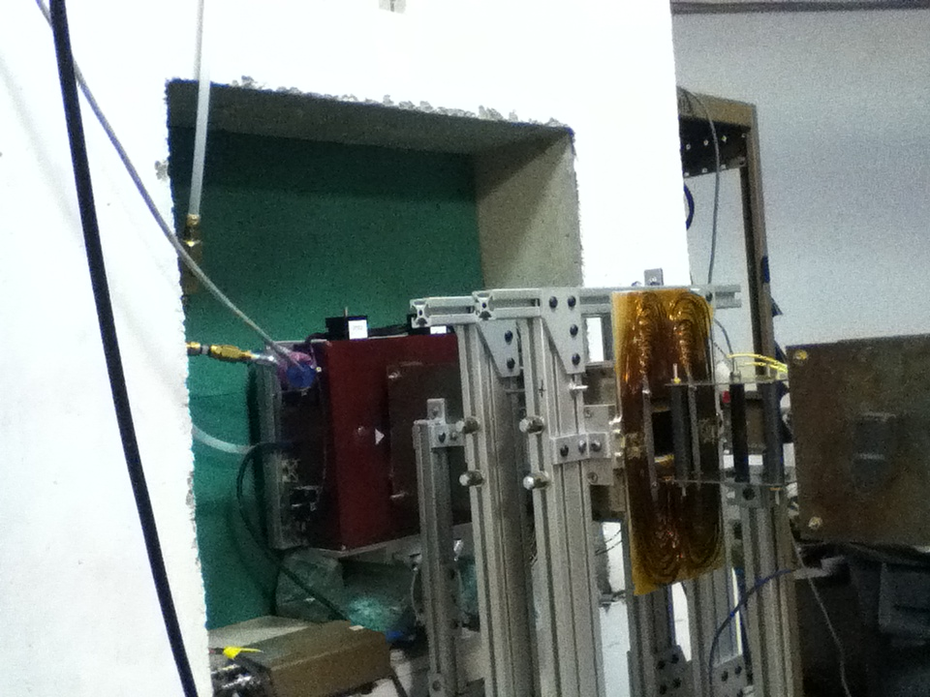
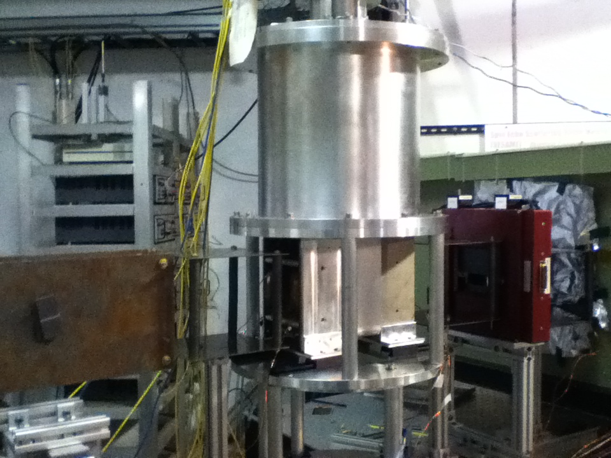
Beam Setup
Cryogenic system
Detector
Guide Field
Analyzer
Vacuum Chamber
Nutator chamber
Front Slit
Back Slit
Front Pi Flipper
Front & Back Electro Magnets
Notes:
Pictures clockwise from the top – Front end view showing permanent magnet guide field and cryo-cup location, vies of instrument, detail of up stream pi flipper (not used except for setup) and detail of guide field/electromagnets around cup.

Slide 18
Experiment Setup
Simple measurement:
Time of flight source – precession angle vs. neutron wavelength
Shifting precession coil current - Precession angle vs. current
Precession Field
Incoming Guide Field
Outgoing Guide Field
Analyzer Field
Notes:
[1] Spherical neutron polarimetry with MuPAD - M. Janoschek (2007)

Slide 19
Polarization vs. Wavelength plot with different precession coil currents
Polarization
4 Angstrom
8 Angstrom
Wavelength

Slide 20
Plot of P/PI=0 and fitting to function
4 Angstrom
8 Angstrom
Wavelength

Slide 21
Fitting Data and the Beam size Comparison
Wavelength
Depolarization: <2% with 20mm beam size
<0.4% with 15mm beam size
<0.1% with 10mm beamsize

Slide 22
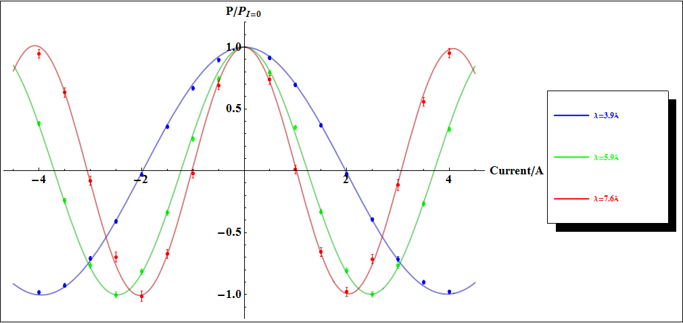
Choosing a Specific Wavelength and plot polarization through different current
Current
Compared to CryoPAD precession: 123.65deg/(A [Ang]), CryoCUP has less precession power: 11.52deg /(A [Ang]).

Slide 23
Experiment summary:
Through the experiment test, it is feasible to use YBCO superconducting film as a magnetic field shield to isolate precession region from outer field
By adjusting the current going through coil, we are able to control the precession angle.
The dephasing factor of <2% is within acceptable range so that the nutator is suitable for next step development
The thermal anchor of cryogenic system is not good, which limited the highest current to 4A
The homogeneity of field generated by Helmholtz coil is not ideal, also the field strength generated is not strong enough
Notes:
[1] Spherical neutron polarimetry with MuPAD - M. Janoschek (2007)

Slide 24
Next step development
Research Steps:
Neutron spin nutator
Spherical neutron spin manipulation
Spherical neutron polarimetry with SANS
Fully functional SNP device
Condensed matter experiment
Further development
(Time of Flight method, advanced sample manipulation……)
Notes:
[1] Spherical neutron polarimetry with MuPAD - M. Janoschek (2007)

Slide 25
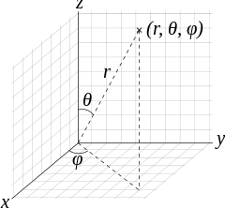
Next step Device development
Guide field on rotation stage
(Spin rotator)
Zero field chamber
Analyzing direction
Front precession field
(spin nutator)
Back precession field
(spin nutator)
Notes:
[1] Spherical neutron polarimetry with MuPAD - M. Janoschek (2007)

Slide 26
Capacity of Spin nutator for SANS experiment
For a typical 90 nutation, 3.438 deg difference is generated, which causes
~ 0.17% depolarization
0.3deg – 5deg
Notes:
[1] Spherical neutron polarimetry with MuPAD - M. Janoschek (2007)

Slide 27
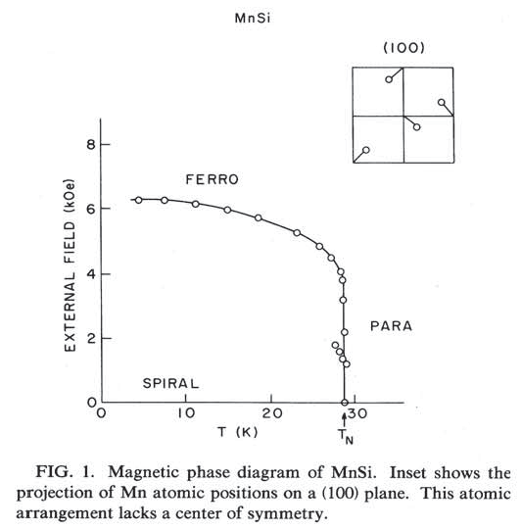
Next Step Device – What experiment?
MnSi – Candidant for SANS experiment
Curie temperature: 29K
Below Tc: single chirality spiral
structure
Propagation vector:
Small Angel scattering experiment
Done by both CryoPAD and MuPAD
Phase Diagram
Notes:
[1] Spherical neutron polarimetry with MuPAD - M. Janoschek (2007)

Slide 28
Research Plan
Research Steps:
Neutron spin nutator
Spherical neutron spin manipulation
Spherical neutron polarimetry with SANS
Fully functional SNP device
Condensed Matter Experiment
(Further Improvement – Time of Flight method)
Notes:
[1] Spherical neutron polarimetry with MuPAD - M. Janoschek (2007)

Slide 29
Next step development
Fully functional SNP device on a Optical Platform?
Spin nutator
Spin rotator
Detachable
Mu-Metal Shield
Sample
Spin nutator
Spin rotator
Analyzer
Optical Platform
Detector
Notes:
[1] Spherical neutron polarimetry with MuPAD - M. Janoschek (2007)

Slide 30
Summary
Spherical Neutron Polarimetry is a very powerful experimental method to detect material.
Develop a device that could fulfill spherical neutron polarimetry experiment method, based on available neutron sources in U.S.
The first step of research, which is making spin nutator has finished, the nutator made is suitable for further development
Still a lot of work to do.
Notes:
[1] Spherical neutron polarimetry with MuPAD - M. Janoschek (2007)

Slide 31
Slit
Slit
Polarizaer &
Monochromater
Analyzer &
Detector
Source
V Coil
Wollaston Prism
V Coil

